Slide 1
Exceptions and other miscellaneous topics

Slide 2
Exceptions
Exceptions occur due to circumstances beyond programmer's control
Invalid data are input
File cannot be accessed
Even though might be user’s fault
Programmer must anticipate
Include code to work around the occurrence

Slide 3
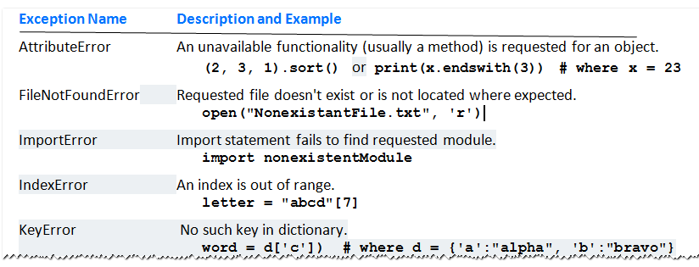
Exceptions
Table 6.1 Some Common Exceptions

Slide 4
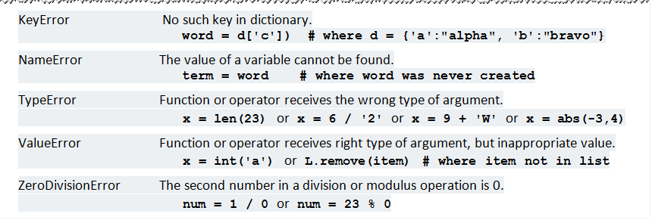
Exceptions
Table 6.1 Some Common Exceptions

Slide 5

Exceptions
Sample problem:
Entry may be non numeric or just <Enter> key
Python gives following error message

Slide 6
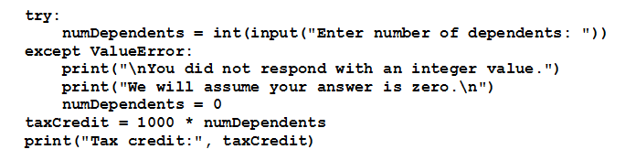
The try Statement
Robust program explicitly handles previous exception
Protecting the code with a try statement.

Slide 7
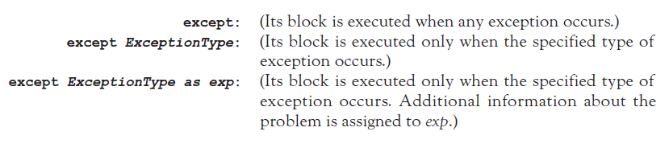
The try Statement
Three types of except clauses:

Slide 8
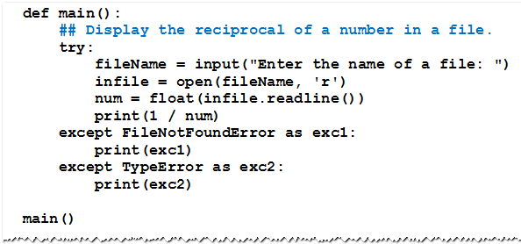
The try Statement
Example 1: Program with different assumptions

Slide 9
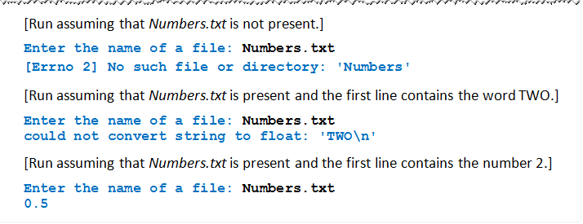
The try Statement
Example 1:

Slide 10
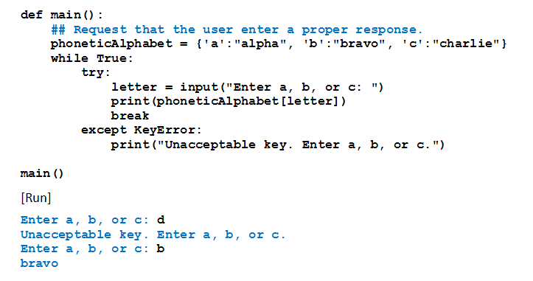
The try Statement
Example 2: Program uses exception handling to guarantee proper response from user.

Slide 11
The else and finally Clauses
try statement also can include a single else clause
Follows the except clauses
Executed when no exceptions occur
try statement can end with a finally clause
Usually used to clean up resources such as files that were left open
try statement must contain either an except clause or a finally clause.

Slide 12
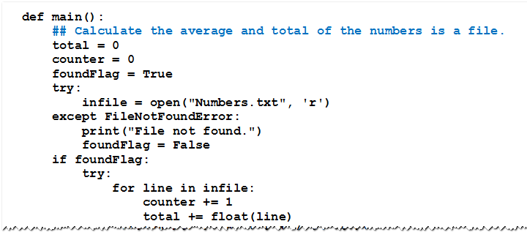
The else and finally Clauses
Example 3: Program attempts to find the average and total of the numbers in a file.

Slide 13
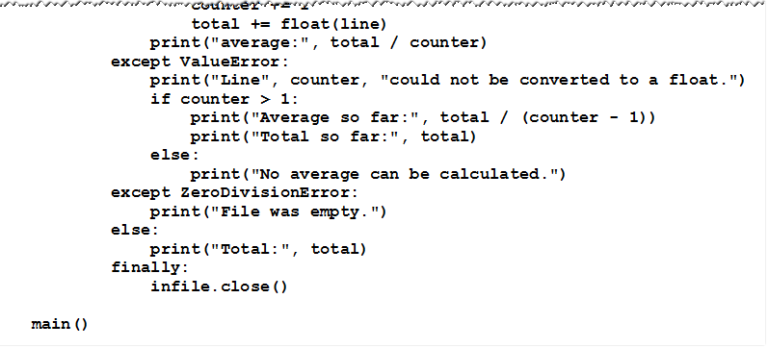
The else and finally Clauses
Example 3:

Slide 14
END Exceptions

Slide 15
Selecting Random Values

Slide 16
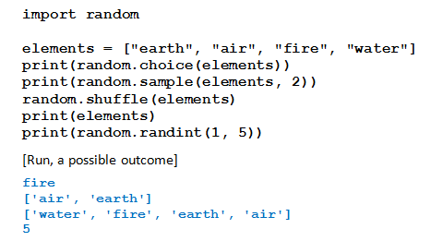
Functions from the random Module
Functions that randomly select items from a list and randomly reorder the items in a list.
Example 1: Program demonstrates functions from the random module.

Slide 17
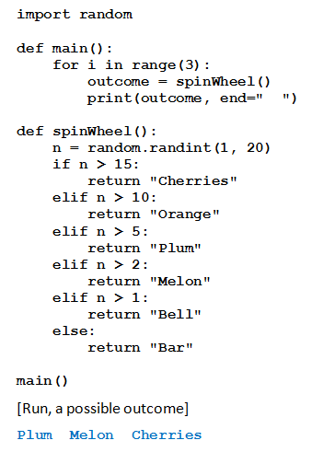
Games of Chance
Example 2: Program simulates outcome from pulling slot machine lever.

Slide 18
END: Selecting Random Values

Slide 19
Serializing Objects
Serialize an object: convert the object to a stream of bytes that can easily be stored in a file
Pickling: serializing an object. Allows us to work with binary files

Slide 20
Serializing Objects (cont’d.)
To pickle an object:
Import the pickle module
Open a file for binary writing
Call the pickle.dump function
Format: pickle.dump(object, file)
Close the file
You can pickle multiple objects to one file prior to closing the file

Slide 21
Serializing Objects (cont’d.)
Unpickling: retrieving pickled object
To unpickle an object:
Import the pickle module
Open a file for binary writing
Call the pickle.load function
Format: pickle.load(file)
Close the file
You can unpickle multiple objects from the file

Slide 22
Recursion

Slide 23


A Recursive Power Function
Recursive function invokes/calls itself
Successive calls reduce to simpler task
Until base case with trivial solution reached
The n^{th} power of a number
Iteratively
Recursively

Slide 24
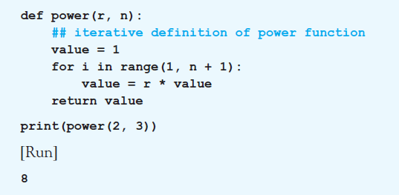
A Recursive Power Function
Example 1: Definition uses the iterative definition of a power.

Slide 25
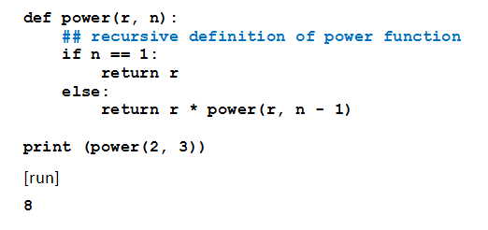
A Recursive Power Function
Example 2: Definition uses the recursive definition of a power.

Slide 26
A Recursive Power Function
Traits of recursive algorithms
One or more base cases with direct solutions.
An "inductive step"
Reducing the problem to one or more smaller versions of the same problem
Reduction eventually culminating in a base case.
Called the reducing step.

Slide 27
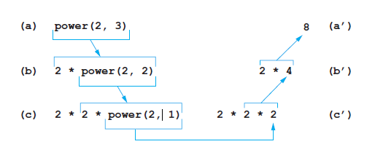
A Recursive Power Function
FIGURE 6.20 The recursive computation of power(2, 3).

Slide 28
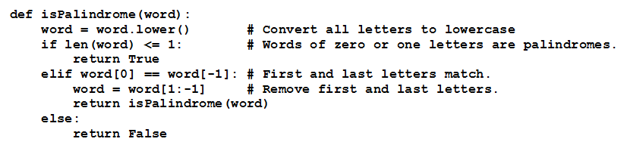
Recursive Palindrome Function
Sometimes a recursive solution is easier to understand and code than iterative routine.
Example 3: Function uses recursion to determine whether or not word is a palindrome.

Slide 29
END : Recursion

